Slide 1

CSCI 466: Networks
Review
Reese Pearsall Fall 2022
https://www.cs.montana.edu/pearsall/classes/fall2022/466/main.html
*All images are stolen from the internet
1

Slide 2

Announcements
No lecture on Wednesday. Workday for PA4. I’ll be in Reid 202 during class time if you need help
Homework 4 due Friday @ 11:59 PM
PA4 due Sunday @ 11:59 PM (We are currently at 49% response rate)
Final Exam: Wednesday December 14th 12:00 – 1:50 PM (same room)

Slide 3
Final Exam Structure
No notes allowed
A curve won’t be applied (unless needed)
15% of your grade
Please show up
Part I. OSI Model
For each layer
Name the layer (Ex. Network Layer)
Provide a primary responsibility/functionality (Ex. Forwarding and Routing)
Provide the unit of data that is being transmitted (Ex. Datagram)
Part II. Short answer questions (~18)
I will pull some of these questions straight from the homeworks (HW1, HW2, HW3)
You can expect 2-4 questions from each the following sections
Internet Structure
Application Layer
Transport Layer
Network Layer (Data Plane)
Network Layer (Control Plane)
Link Layer
Network Security

Slide 4
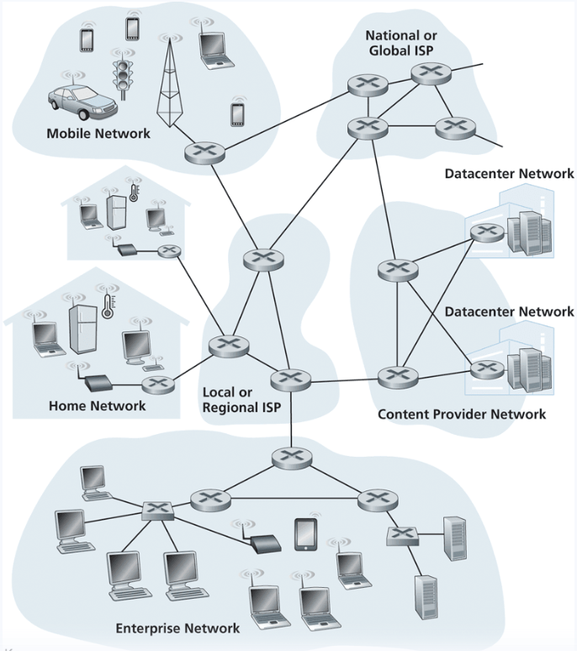







Internet Structure
Devices that are connected to network are called hosts or end systems
Two types: Clients and Servers
End systems are connected together by a network of communication links and packet switches/routers
The network edge consists of end systems
The network core consists routers and other packet switches (usually owned by an ISP)

Slide 5

Internet Structure
Devices that are connected to network are called hosts or end systems
Two types: Clients and Servers
End systems are connected together by a network of communication links and packet switches/routers
The network edge consists of end systems
The network core consists routers and other packet switches (usually owned by an ISP)

Slide 6





Internet Structure
Devices that are connected to network are called hosts or end systems
Two types: Clients and Servers
End systems are connected together by a network of communication links and packet switches/routers
The network edge consists of end systems
The network core consists routers and other packet switches (usually owned by an ISP)

Slide 7

Internet Structure
Devices that are connected to network are called hosts or end systems
Two types: Clients and Servers
End systems are connected together by a network of communication links and packet switches/routers
The network edge consists of end systems
The network core consists routers and other packet switches (usually owned by an ISP)

Slide 8

Internet Structure
Devices that are connected to network are called hosts or end systems
Two types: Clients and Servers
End systems are connected together by a network of communication links and packet switches/routers
The network edge consists of end systems
The network core consists routers and other packet switches (usually owned by an ISP)

Slide 9
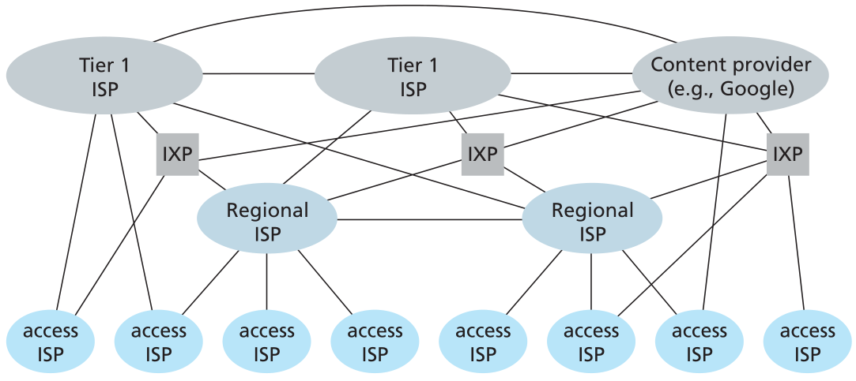
Internet Structure
The internet is hierarchical. We access the internet through an ISP, which typically belong to a larger network
Big ISP : 192.xxx.xxx.xxx
Sub ISP: 192.42.xxx.xxx
Sub ISP: 192.42.221.xxx

Slide 10
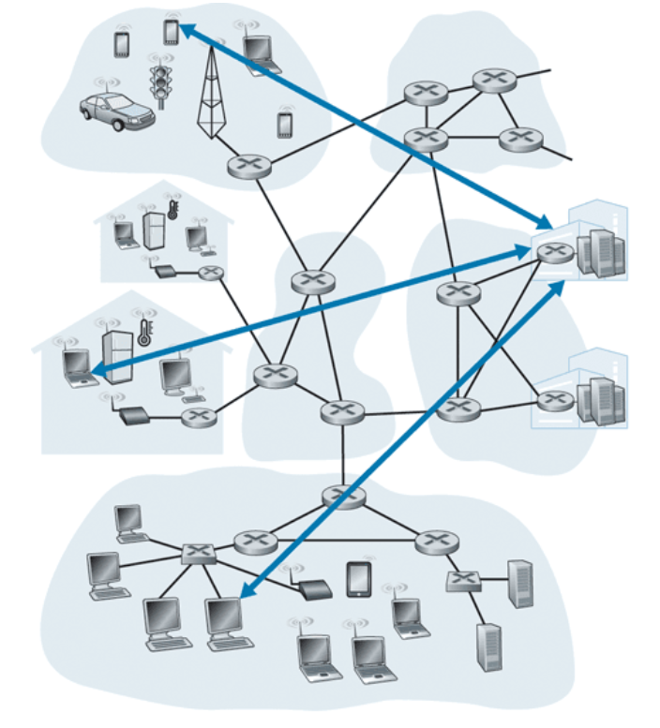

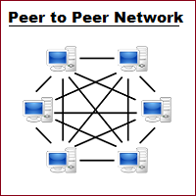
Internet Structure
Client-server architecture
Clients do not directly interact with each other.
Hosts communicate with a dedicated, always online server that acts as a middleman between two hosts. Servers are usually hosted in a data center
“Server”
+ Easier to administer
+ More secure
+ Ability to back up data
Potential single point of failure
Expensive
Distance
“Client”
P2P Architecture
No reliance on a dedicated server
Each endpoint has same power and responsibilities.
Endpoints can be both a server and an endpoint
+ No central server + Availability
+ Self Scaling
Less Secure - ISP Friendliness
More difficult to administer

Slide 11
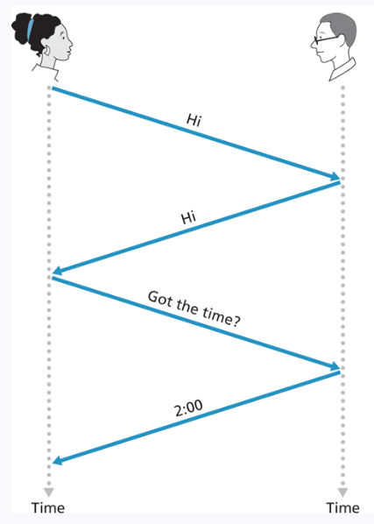
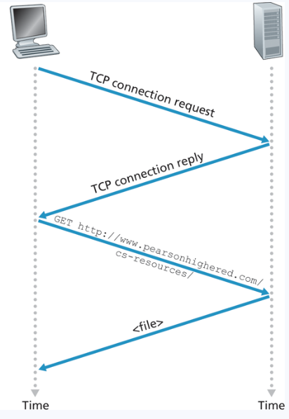
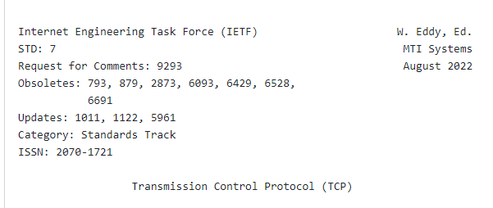
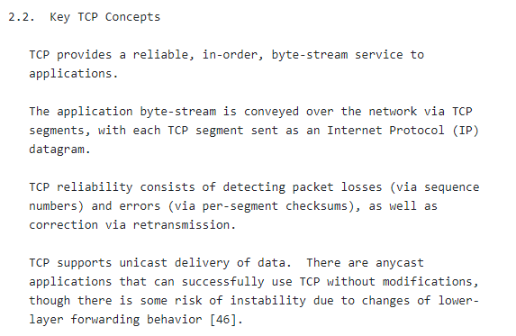
Internet Structure
A protocol defines the format and the order of messages exchanges between two or more communicating entities, as well as the actions taken on the transmission and/or receipt of the message or event
The rules and details are always specific in an RFC

Slide 12
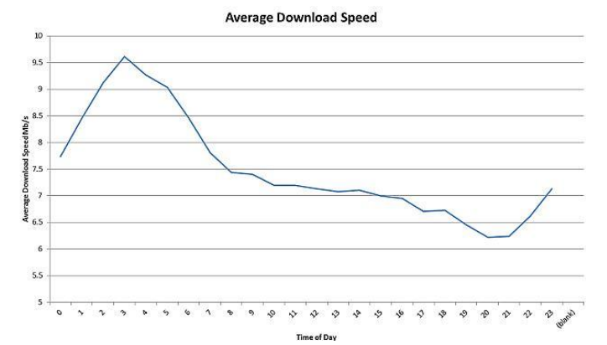
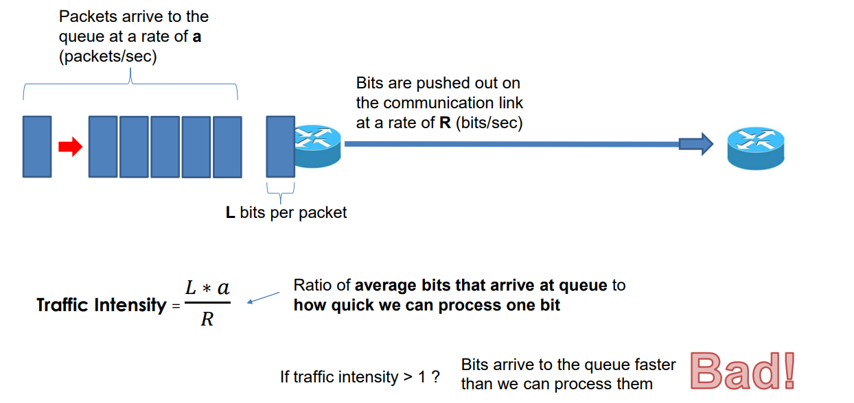
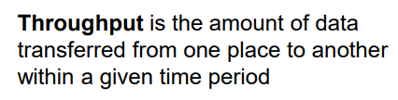
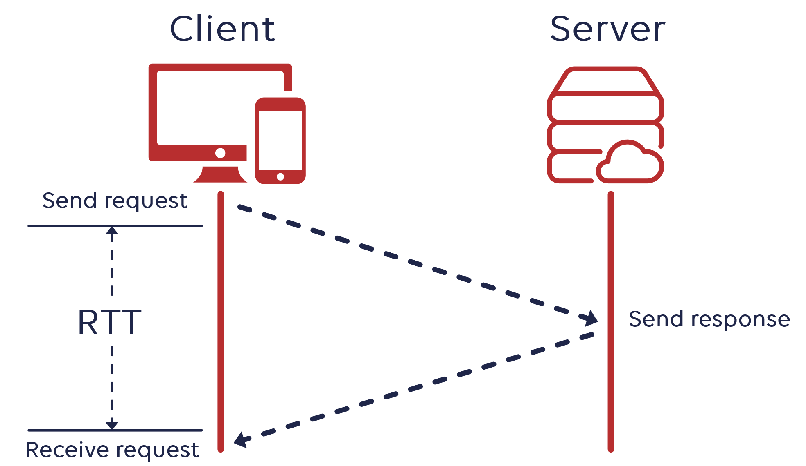




Internet Structure
(A lot of factors affect throughput)
You won’t need to calculate these values on the final exam, but you should have an understanding of what they measure and the meaning of that value
Round time trip

Slide 13
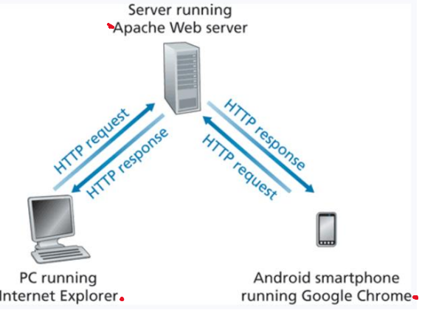
Application Layer
The layer which interacts directly with applications and provide necessary protocols and services for web applications. Specifies the shared commination protocol(s) that will be used by hosts in a communication protocol
Humans interact through the application layer. Application layer also provides engineers an interface and methods for web communication
HyperText Transfer Protocol (HTTP)- protocol that dictates the transmitting of hypermedia documents, such as HTML and other webpage objects

Slide 14
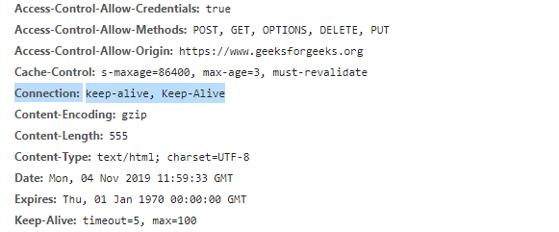
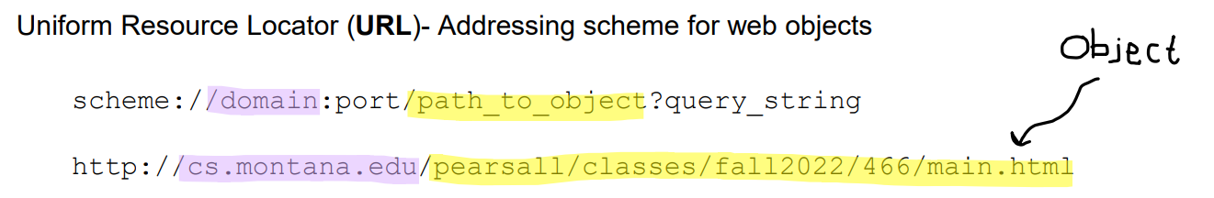


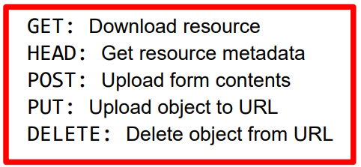

Application Layer
On the final exam, you should be able to describe (from a high level) how HTTP works)
HyperText Transfer Protocol (HTTP)- protocol that dictates the transmitting of hypermedia documents, such as HTML and other webpage objects
HTTP Request
We provide the URL for the web resource that we want
HTTP is built on TCP, so an HTTP client will first initiate A TCP connection (port 80) and establish a connection socket and does the TCP handshake
HTTP Request
TCP
TCP
The HTTP client sends an HTTP Request to the server via its socket

Slide 15
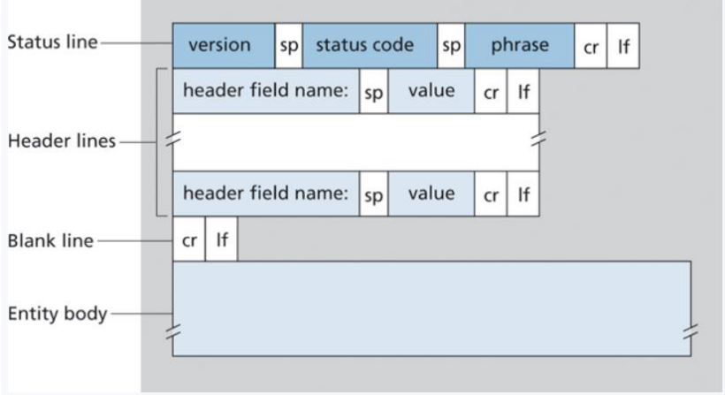


Application Layer
On the final exam, you should be able to describe (from a high level) how HTTP works)
HyperText Transfer Protocol (HTTP)- protocol that dictates the transmitting of hypermedia documents, such as HTML and other webpage objects
We provide the URL for the web resource that we want
The HTTP server process the request, retrieves the object, and sends it back to the client as an HTTP response
HTTP is built on TCP, so an HTTP client will first initiate A TCP connection (port 80) and establish a connection socket and does the TCP handshake
HTTP Request
TCP
HTTP Response
TCP
Informational Responses (100s)
Successful Responses (200s)
Redirection messages (300s)
Client error response (400s)
Server error response (500s)
The HTTP client sends an HTTP Request to the server via its socket

Slide 16
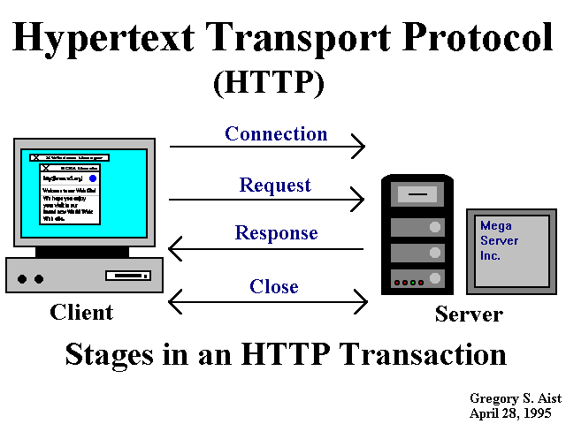
Application Layer
On the final exam, you should be able to describe (from a high level) how HTTP works)
HyperText Transfer Protocol (HTTP)- protocol that dictates the transmitting of hypermedia documents, such as HTML and other webpage objects
Probably someone in this class: Who cares??
When you graduate and get your job as a software engineer/web developer, the application you are writing, or the API you are working with will be using HTTP to communicate with other hosts.
It’s important to have an understanding and intuition about what’s going on under the head, and to quickly remember the structure of an HTTP request (GET, URL) and the structure of an HTTP response (200 OK)

Slide 17
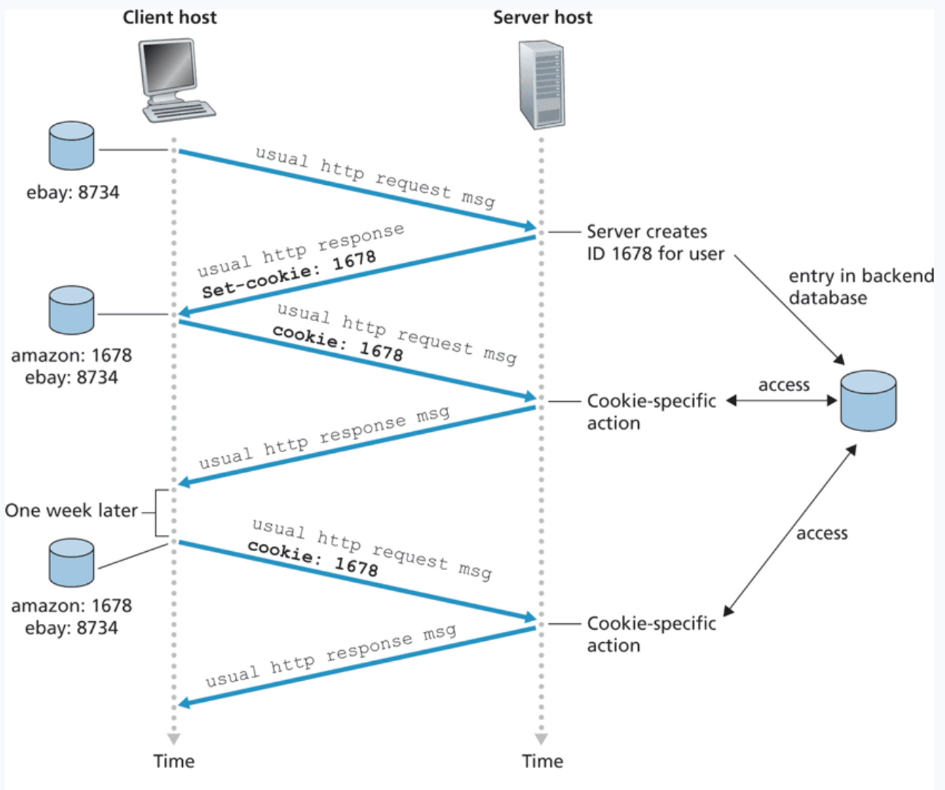
Application Layer
On the final exam, you should be able to describe (from a high level) how HTTP works)
HyperText Transfer Protocol (HTTP)- protocol that dictates the transmitting of hypermedia documents, such as HTML and other webpage objects
Cookies are pieces of information that are exchanged between browsers and web servers to identify users in active connections
Authentication
Tracking & Advertisement
Session Management

Slide 18
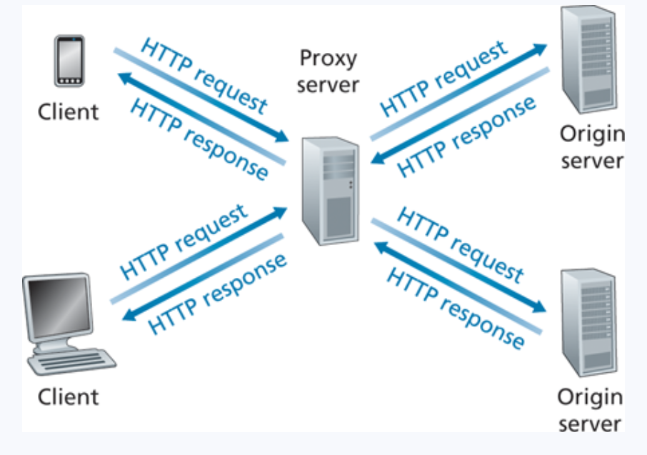
Application Layer
On the final exam, you should be able to describe (from a high level) how HTTP works)
HyperText Transfer Protocol (HTTP)- protocol that dictates the transmitting of hypermedia documents, such as HTML and other webpage objects
A web cache– also called a proxy server– is a network entity that satisfies HTTP requests on the behalf of an origin Web server
* Improves response time (especially if the the cache has the object that is requested)
* The connection from the client to the cache is typically much faster than the connection from client to host server
1. Browser/Client establishes a TCP connection to the Web cache and sends an HTTP request
2. Web cache checks its local storage for the requested object
3. If the web cache does not have the object, establish TCP with an origin server and issue an HTTP request
4. Web cache stores a local copy of the object, then issues an HTTP response with the object

Slide 19

Application Layer
File Transfer Protocol (FTP)- protocol used for transferring files from server to client
FTP procedure:
FTP client contacts FTP server at port 21, using TCP
Client authorized over control connection
Client browses remote directory, sends commands over control connection
When server receives file transfer command, server opens 2nd TCP data connection (for file) to client
After transferring one file, server closes data connection
TCP control connection,
server port 21
FTP
client
TCP data connection,
server port 20
FTP
server
FTP communicates over two connections
Port 21 for control information
Port 20 for data
Differences from HTTP
Control communication “out-of-band”
Server maintains per client state: authentication, current directory

Slide 20







Application Layer
DNS is a distributed, hierarchical database used for mapping hostnames to IP address (no DNS server has all the records!)
On the final exam, you should be able to describe (from a high level) how DNS works
Prior to creating a TCP connection and sending an HTTP request, we first need to issue a DNS request!
(Built on UDP, lookups happen on port 53)
Hierarchy consists of different types of DNS servers:
root DNS server
Authoritative DNS servers- Organization’s own DNS with up-to-date records
.com TLD DNS server
.edu TLD DNS server
Top-level domain (TLD) servers- responsible for keeping IP addresses for authoritative DNS servers for each top-level domain (.com, .edu, .jp, etc)
facebook.com DNS
amazon.com DNS
montana.edu DNS
harvard.edu DNS

Slide 21
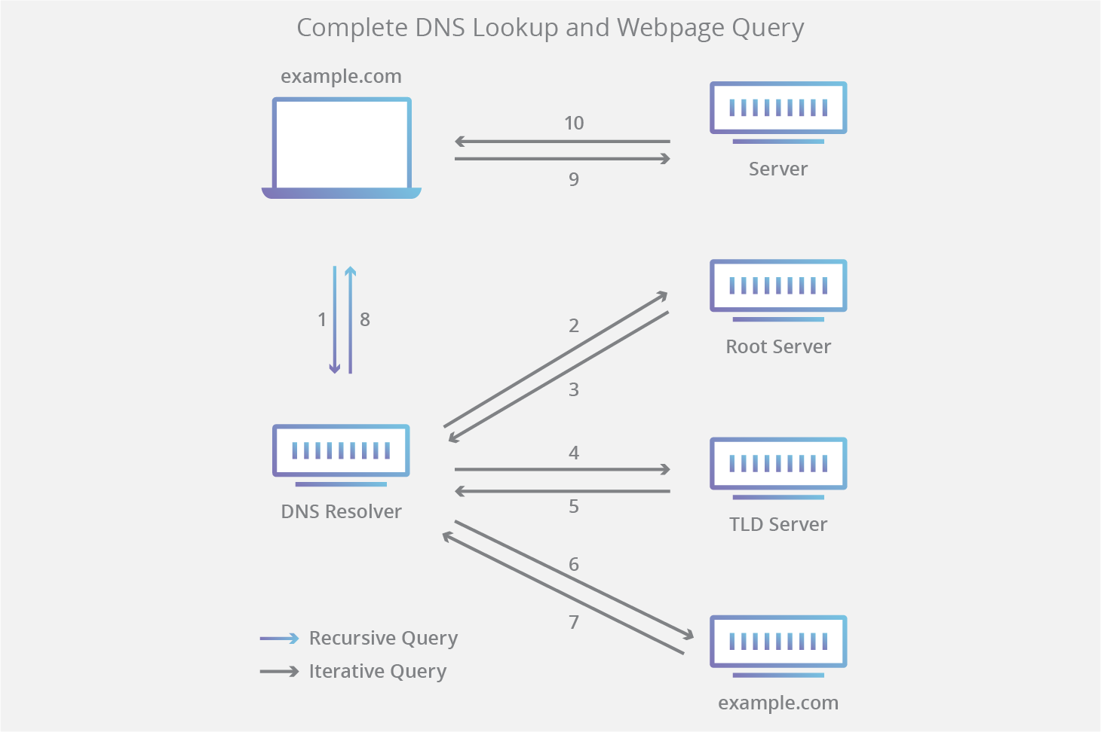
Application Layer
DNS is a distributed, hierarchical database used for mapping hostnames to IP address (no DNS server has all the records!)
On the final exam, you should be able to describe (from a high level) what DNS is and how DNS works
Prior to creating a TCP connection and sending an HTTP request, we first need to issue a DNS request!
(Built on UDP, lookups happen on port 53)
There are also local DNS servers, and local DNS entries on your machine
Root DNS servers- responsible for maintaining IP addresses for TLD servers
Top-level domain (TLD) servers- responsible for keeping IP addresses for authoritative DNS servers for each top-level domain (.com, .edu, .jp, etc)
Authoritative DNS servers- Organization’s own DNS with up-to-date records
example.com
authoritative DNS server

Slide 22
Transport Layer
- Provides host-to-host, reliable data transfer, and dictates the flow of data
Our messages from the application are now divided up into transport layer segments
TCP Header
UDP Header
Payload
Payload
HTTP Request
TCP Header
DNS Query
Payload
UDP Header
Payload
TCP Header
Payload
UDP Header
Payload
TCP Header
Payload
UDP Header
Payload
TCP Header
Payload
UDP Header
Payload
TCP Header
UDP Header
Payload
Payload

Slide 23
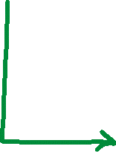
Transport Layer
- Provides host-to-host, reliable data transfer, and dictates the flow of data
Multiplexing is the process of gathering chunks from sockets, encapsulating chunks with header information, and passing the segment into the network layer
Demultiplexing is the receiving segments from the transport layer and delivering the segment to the correct socket.
Socket
Socket
Socket
Segment
Socket
data
data
header
data
header
data
header
data
data
header
data
header
data
header
data

Slide 24
Transport Layer
- Provides host-to-host, reliable data transfer, and dictates the flow of data
Segments are delivered to a port (which a socket is linked to)
Service | Port
HTTP | 80
HTTPS | 443
DNS | 53
FTP | 20 and 21
SSH | 22
BGP | 179
Different services/protocols are linked to different ports
Port 1
Port 2
Port 3
….
Port 80
Port N
80
These are some common ports you should really know for the final exam ☺

Slide 25
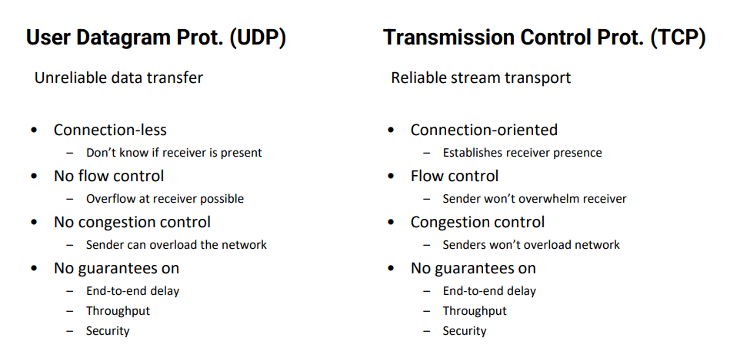
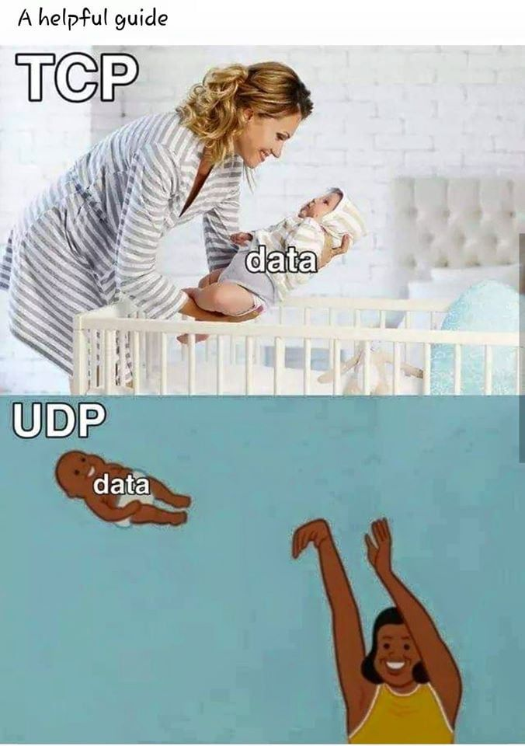
Transport Layer
- Provides host-to-host, reliable data transfer, and dictates the flow of data

Slide 26
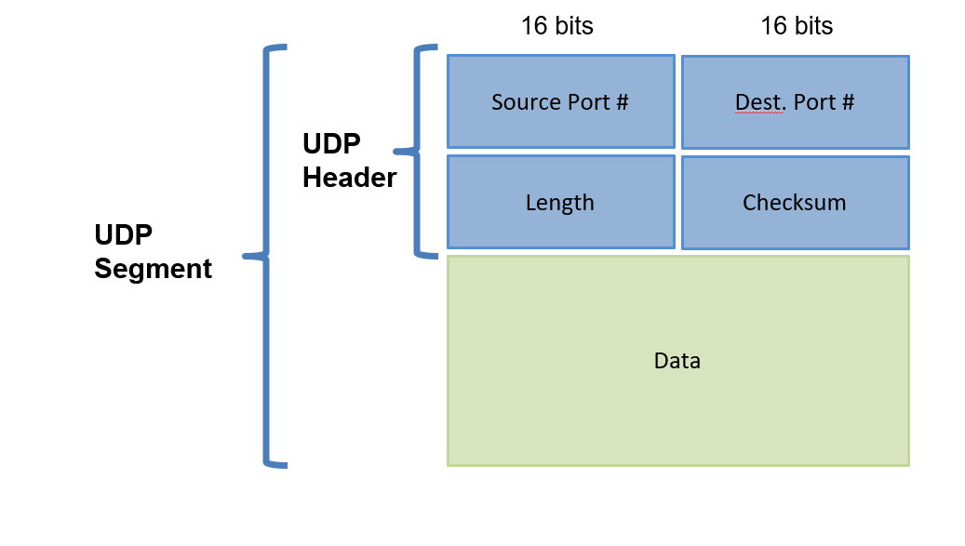
Transport Layer
- Provides host-to-host, reliable data transfer, and dictates the flow of data

Slide 27
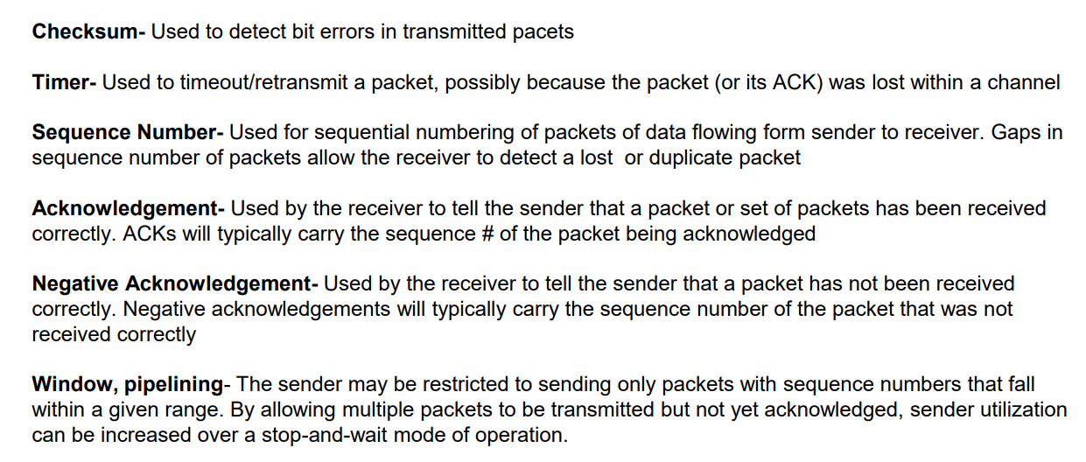
Transport Layer
- Provides host-to-host, reliable data transfer, and dictates the flow of data
It would be very helpful for you to review these ☺

Slide 28
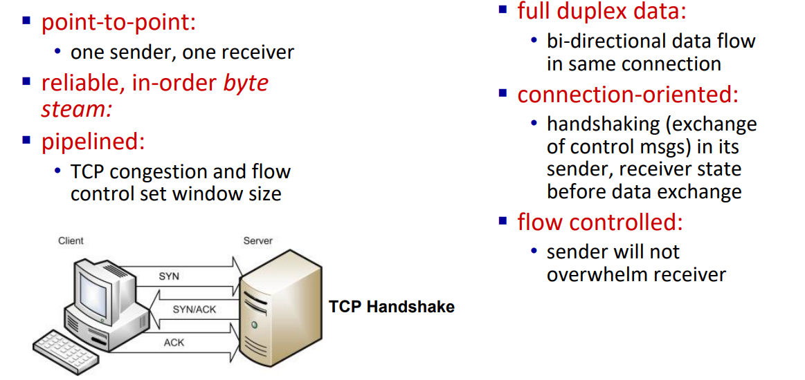
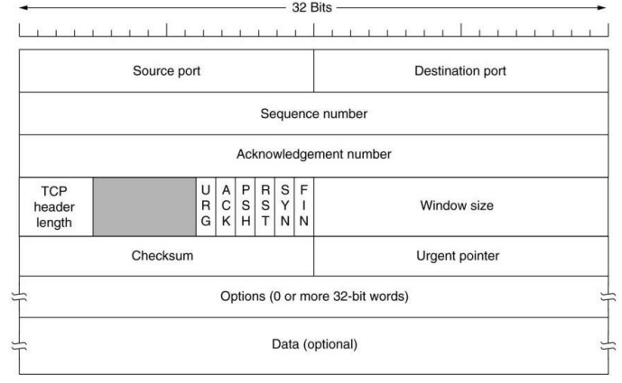









Transport Layer
- Provides host-to-host, reliable data transfer, and dictates the flow of data

Slide 29
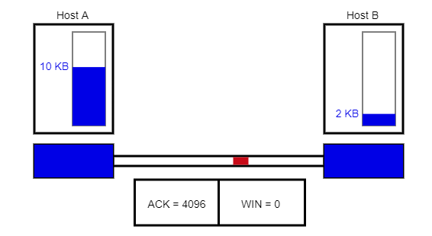
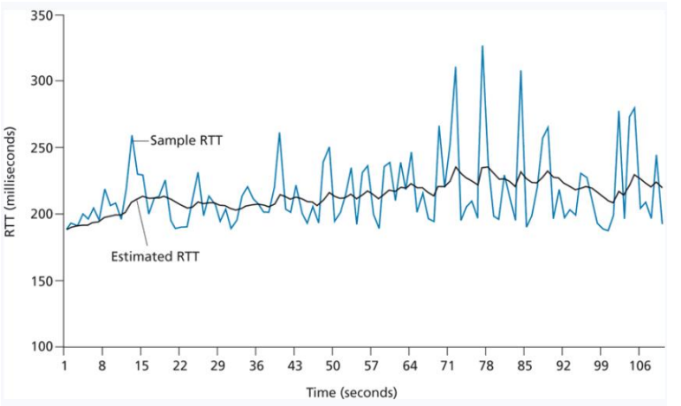
Transport Layer
- Provides host-to-host, reliable data transfer, and dictates the flow of data
TCP sends back amount of available buffer space in the receiver
The timeout value for TCP is dynamically calculated by looking at RTT values for packets
This helps make sure we don’t overwhelm the receiver
TCP is self-clocking, which means it will control itself if it notices congestion in a network
-See how many dropped packets we are getting
-Amount of duplicate ACKs received
-Amount of UnAcked packets

Slide 30
Transport Layer
- Provides host-to-host, reliable data transfer, and dictates the flow of data
Given a scenario and application requirements, you should be able to pick between UDP and TCP and give a reasonable justification for your choice

Slide 31






Network Layer
- Provides Routing and Forwarding Functionality
Our segments from the transport layer are now encapsulated into network layer datagrams
IP Header
TCP Header
Payload
Forwarding: move packets from router’s input to appropriate router output
Routing: determine route taken by packets from source to destination

Slide 32
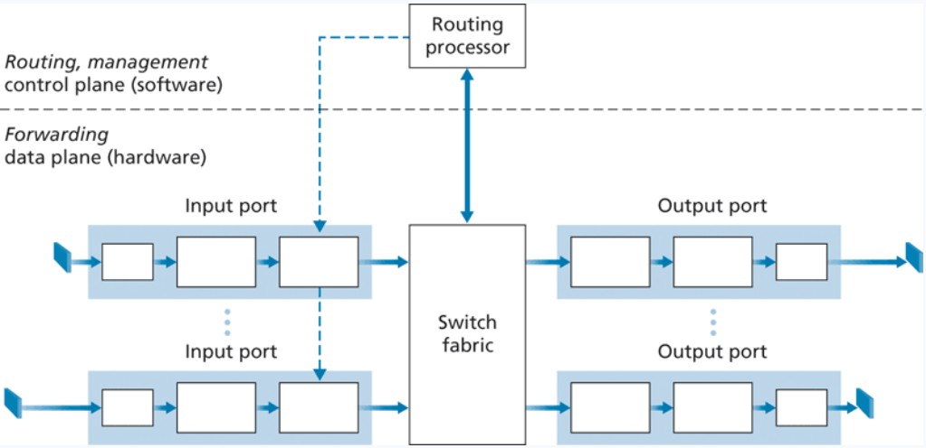
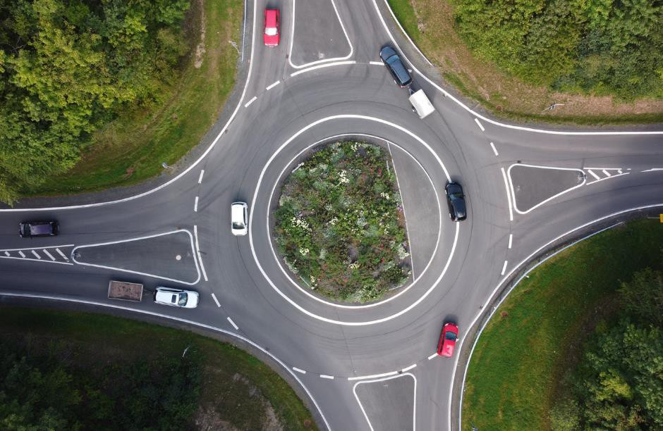
Network Layer
- Provides Routing and Forwarding Functionality
Destination-based forwarding
Forwarding decisions are based on the destination of the packet
Generalized forwarding
Forwarding decisions based on any set of header field values

Slide 33
Network Layer
Longest prefix matching
when looking for forwarding table entry for given destination address, use longest address prefix that matches destination address
- Provides Routing and Forwarding Functionality
Address range | Interface (output link)
11001000 00010111 00010*** ********* | 1
11001000 00010111 00011000 ********* | 2
11001000 00010111 00011*** ******** | 3
otherwise | 4
Destination-based forwarding
Forwarding decisions are based on the destination of the packet
Routing Table
Address range | Interface (output link)
128.11.52.0 – 128.11.52.255 | 1
153.90.2.0 – 153.90.2.255 | 2
153.90.2.87 – 153.90.2.89 | 3
Lookup, forwarding, queueing
Routing Tables are maintained internally, and help make forwarding decisions
…
…

Slide 34




Network Layer
Longest prefix matching
when looking for forwarding table entry for given destination address, use longest address prefix that matches destination address
- Provides Routing and Forwarding Functionality
BIG ISP
Smaller ISP
Address range | Interface (output link)
128.28.113.XXX | 1
128.28.114.XXX | 2
Address range | Interface (output link)
128.28.XXX.XXX | 1
128.27.XXX.XXX | 2
Even Smaller ISP
Address range | Interface (output link)
128.28.114.23 | 1
128.27.114.16 | 2
128.27.114.44 | 3
Smaller ISP
Even Smaller ISP
Address range | Interface (output link)
128.28.113.1 | 1
128.27.113.2 | 2
128.27.113.3 | 3
Address range | Interface (output link)
128.27.1.XXX | 1
128.27.2.XXX | 2

Slide 35
Network Layer
- Provides Routing and Forwarding Functionality
IP Address: Globally unique* 32 bit (4 byte) dotted decimal number assigned to interfaces on hosts and routers
(Think of this as your ZIP code)
193.32.216.9
=
11000001 00100000 11011000 00001001
128 | 64 | 32 | 16 | 8 | 4 | 2 | 1
1 | 1 | 0 | 0 | 0 | 0 | 0 | 1
128 + 64 + 1 = 193
193 = 11000001 in binary

Slide 36
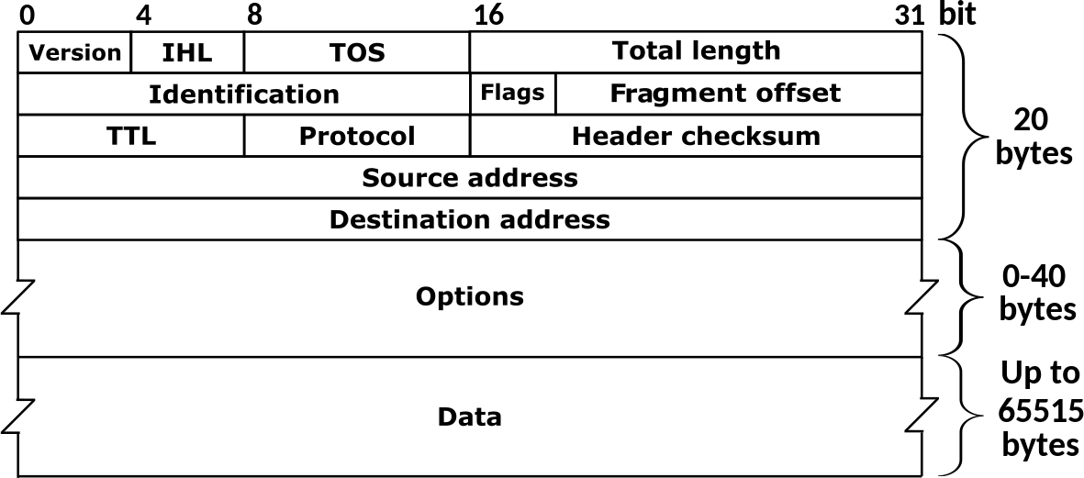
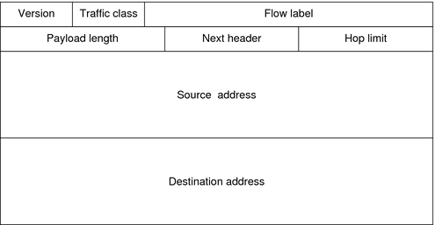
Network Layer
- Provides Routing and Forwarding Functionality
On the final exam, you should know the difference between IPv4 and IPv6, and why we need IPv6
IP Protocol
IPv4
IPv6
IPv4: 32-bit addresses (decimal)
192.149.252.76
IPv6: 128-bit addresses (hexademical)
3ffe:1900:fe21:4545::

Slide 37
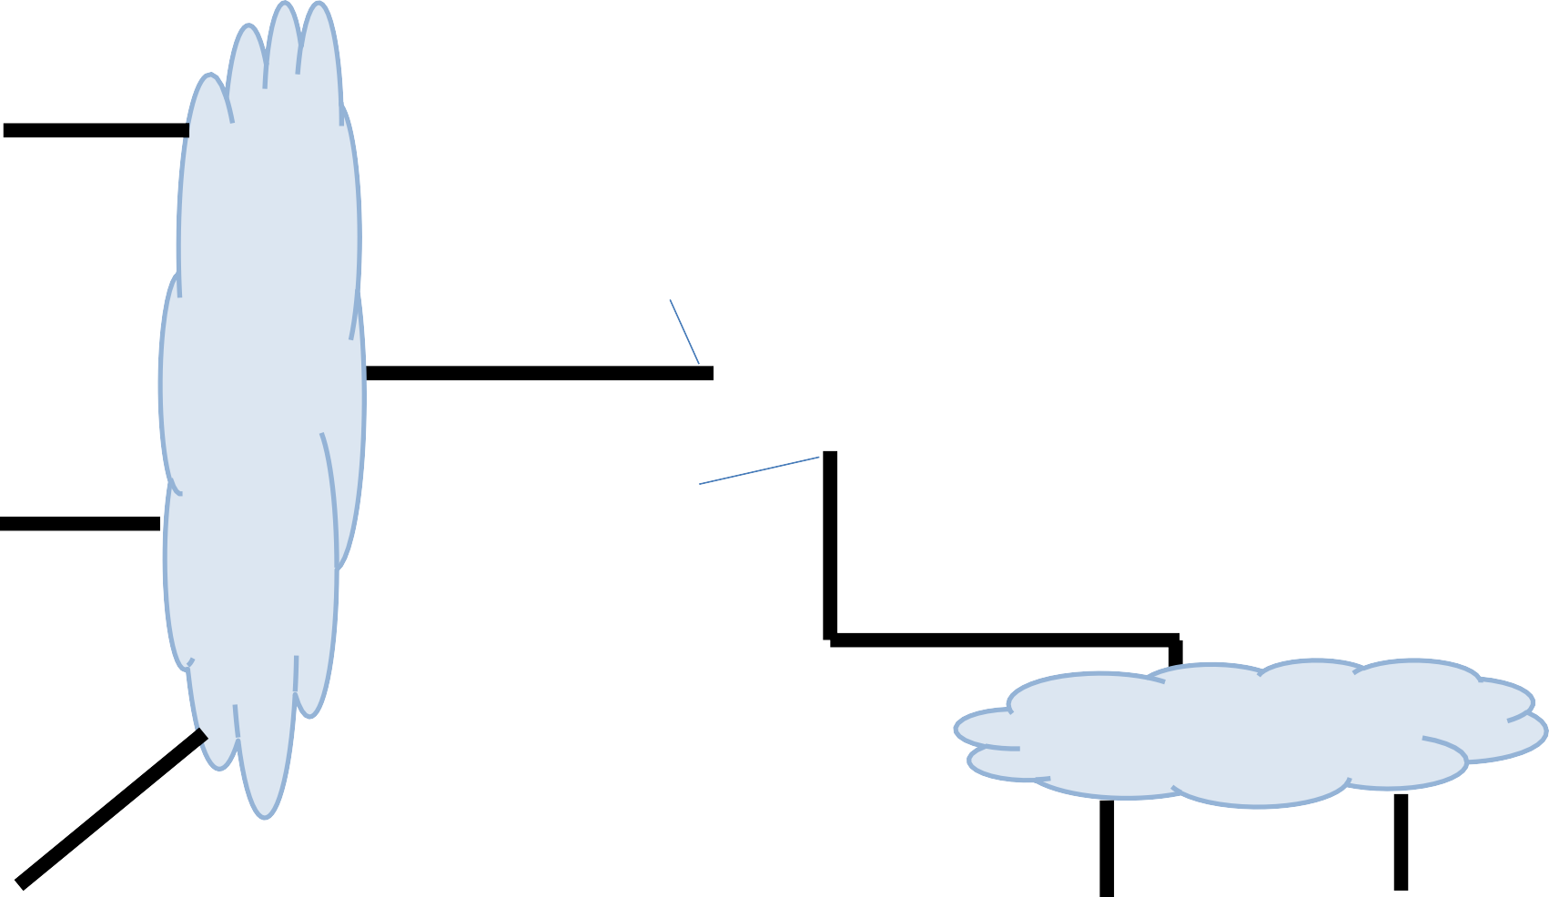

Network Layer
- Provides Routing and Forwarding Functionality
223.1.2.1
223.1.1.1
223.1.1.4
223.1.2.9
223.1.2.2
223.1.3.27
223.1.1.2
Subnet is a logical subdivision of an IP network
223.1.1.3
223.1.3.1
223.1.3.2

Slide 38
Subnet is a logical subdivision of an IP network In this network, we have 3 subnets
Computers usually have 1
interface. Routers have many
223.1.2.1
223.1.1.1
223.1.1.4
223.1.2.9
223.1.2.2
223.1.3.27
223.1.1.2
Devices usually have a private IP address, and a public IP address
IP addresses on the same subnet share a common prefix
Hosts on the same subnet can reach each other without going through a router
223.1.1.3
223.1.3.1
223.1.3.2

Slide 39

Network Layer
- Provides Routing and Forwarding Functionality
It is very common to have a range of IP addresses assigned to you (random assignment would be chaos)
Subnet mask
223.1.1.0/24
The leftmost 24 bits represent the prefix of the subnet
11111111 11111111 11111111 XXXXXXXX = 255.255.255.0
(We can have /8, /16, /1, /2, /3, etc)
223.1.1.1
223.1.1.67
223.2.1.67
223.2.1.255
223.1.1.2
The number of host bits available controls the amount of IP addresses available to you
(more host bits = more available IP addresses)
…
193.32.216.9
Network bits
Host bits
223.1.1.253
11000001 00100000 11011000 00001001

Slide 40
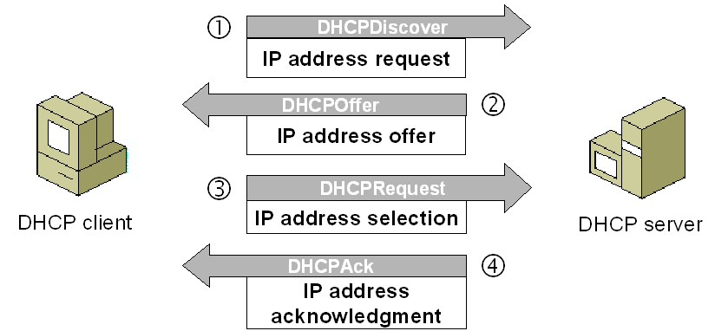
Network Layer
Dynamic Host Configuration Protocol (DHCP) is a plug-and-play, client-server protocol that allows a host to obtain an IP address automatically
When a host is automatically assigned an IP address, it might keep that one forever, or the IP addresses can be temporary
(more common)
On the final exam, you should know what DHCP is, and when it is used

Slide 41
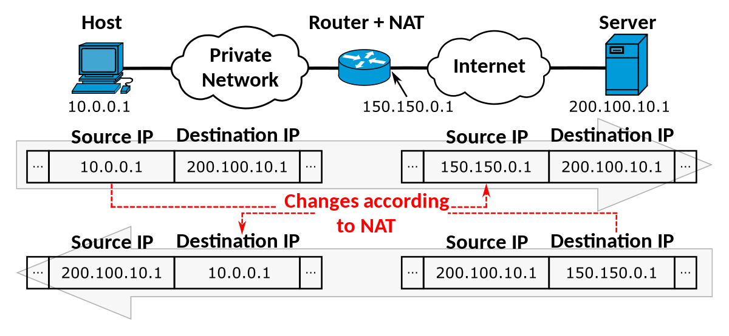

Network Layer
NAT is a translation of multiple private IP addresses to one single public IP address
Hides details of inner home network from outside world
All incoming traffic will have same public IP, all outgoing will have same public IP
Routers get assigned their one public IP address through DHCP!

Slide 42
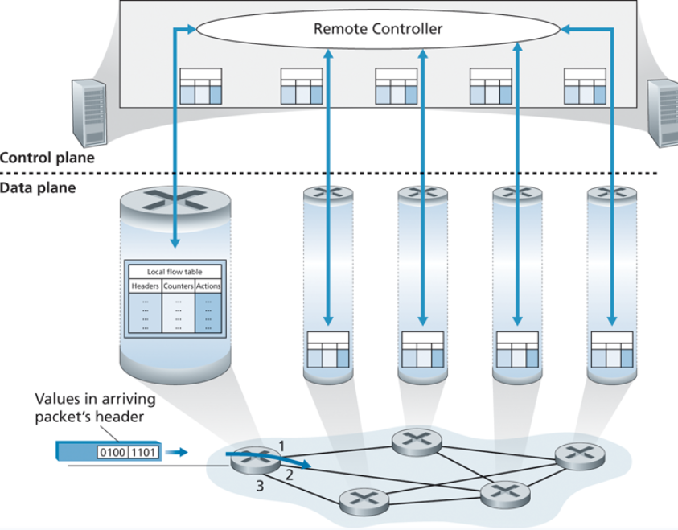
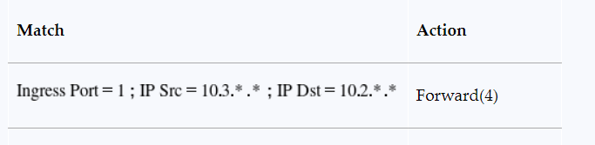
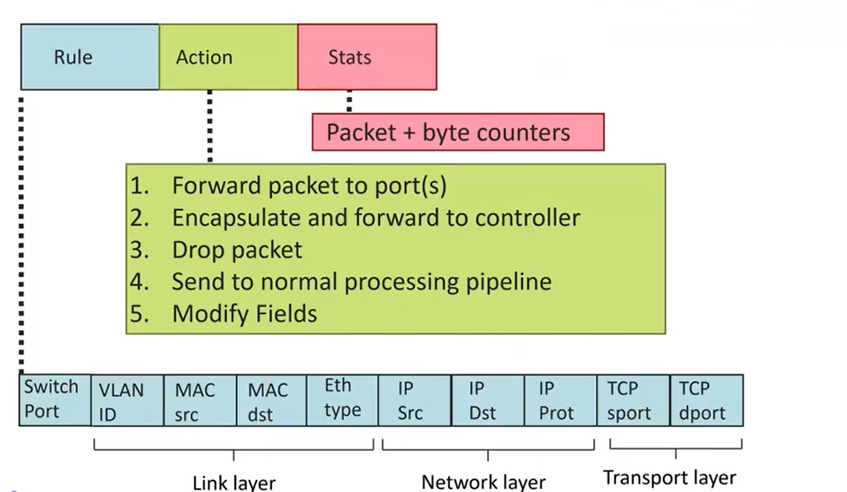
Network Layer
Generalized Forwarding and Software Defines Network (SDN)
OpenFlow Standard
We need headers/rules, which are going to the values the remote controller is going to evaluate
We need actions to do based on some pattern match

Slide 43
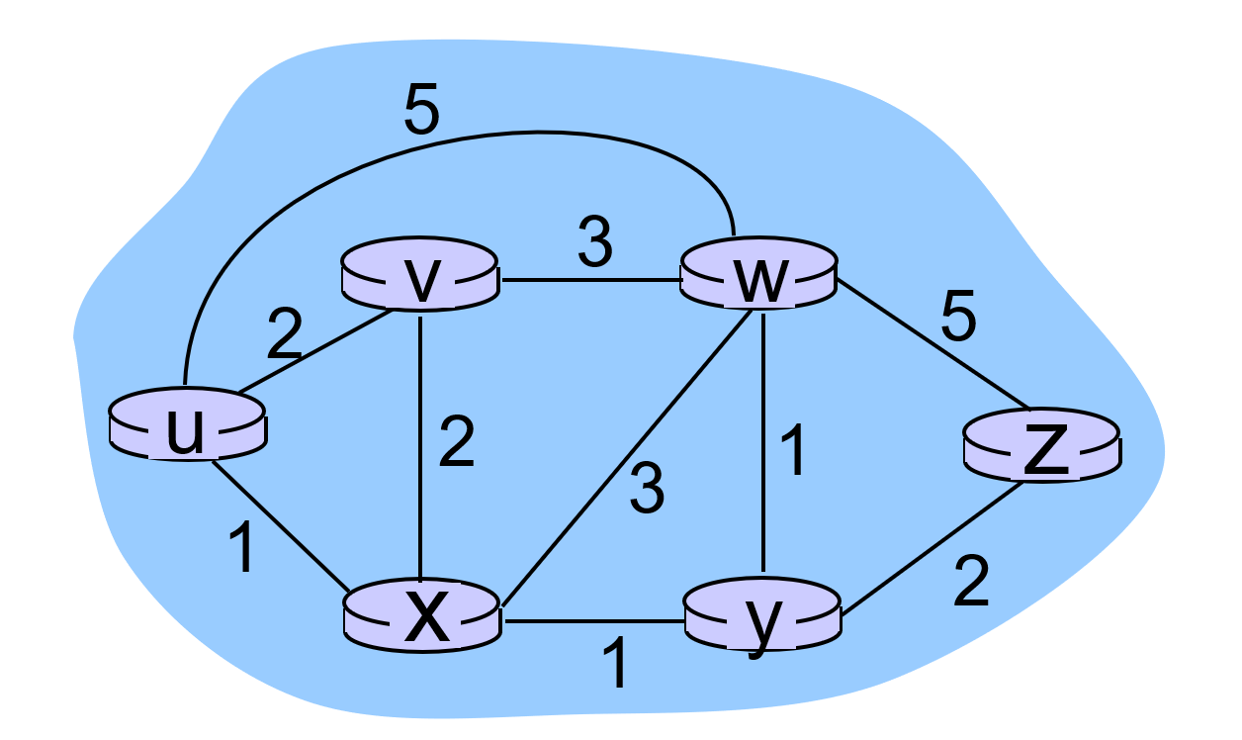
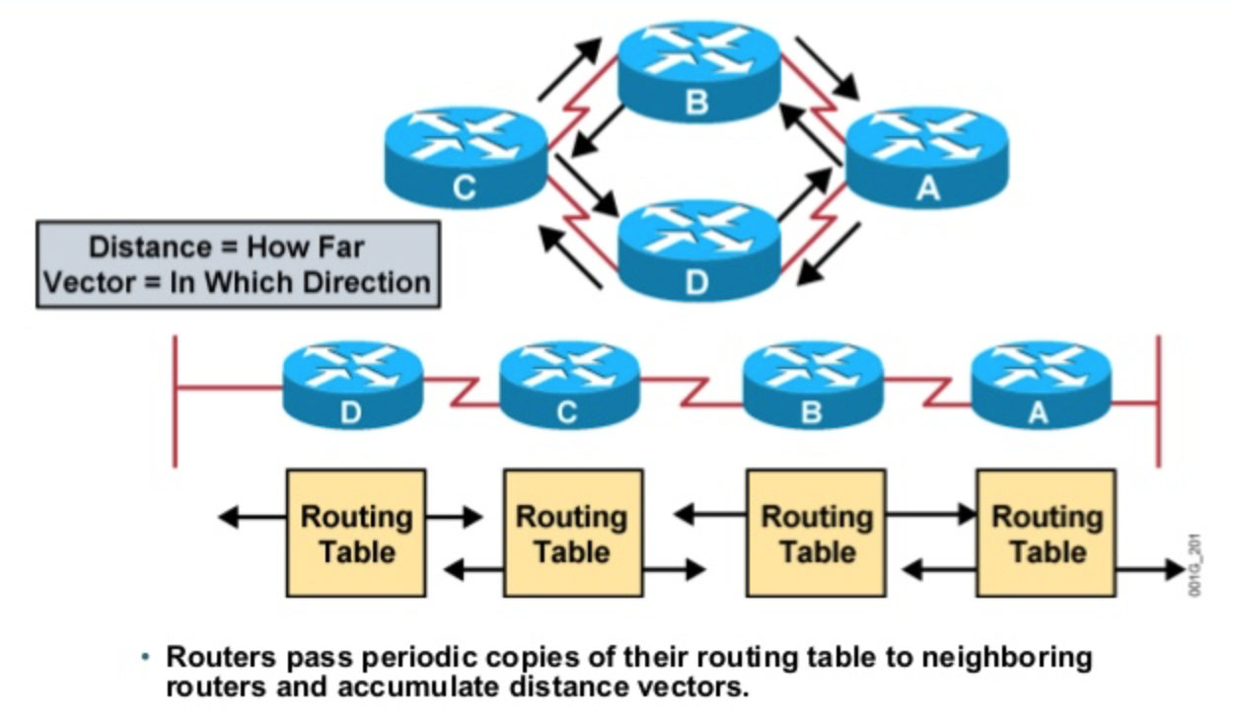
Network Layer (Routing)
On the final exam, you should know the differences between these two algorithms, and from a high-level how they work
Routing Algorithms
Link State
AKA Dijkstra’s algorithm
Centralized Algorithm (requires edge costs of entire network)
Updates are event triggered
Distance Vector
Frequently exchange routing table information between neighbors
Not centralized (does not requires edge costs of entire network beforehand)
Updates happen frequently

Slide 44







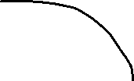



Network Layer (Routing)
An autonomous system is a group of routers that are under the same administrative control
OSPF is a link-state protocol that uses flooding of link-state information and Dijkstra’s least-cost algorithm
→ Used for routing within an AS
Border Gateway Protocol (BGP) is used for exchanging routing information between AS
AS 1
On the final exam, you should know when BGP is used, and when OSPF is used

Slide 45
Network Layer (Routing)
ICMP (Internet Control Message Protocol)
used by hosts & routers to communicate network-level information
error reporting: unreachable host, network, port, protocol
echo request/reply (used by ping)
network-layer “above” IP:
ICMP msgs carried in IP datagrams
ICMP message: type, code plus first 8 bytes of IP datagram causing error
Type Code description
0 0 echo reply (ping)
3 0 dest. network unreachable
3 1 dest host unreachable
3 2 dest protocol unreachable
3 3 dest port unreachable
3 6 dest network unknown
3 7 dest host unknown
4 0 source quench (congestion
control - not used)
8 0 echo request (ping)
9 0 route advertisement
10 0 router discovery
11 0 TTL expired
12 0 bad IP header

Slide 46
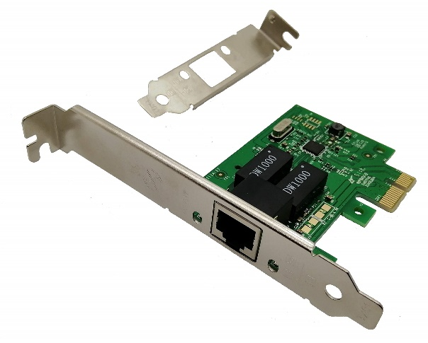
Link Layer
Datagrams get encapsulated into frames
The link layer is responsible for the actual node-to-node delivery of data and ensure error-free transmission of information (handles a variety of mediums)
NIC (Network Interface Controller)- Integrated into the motherboard and allows the machine to use LL services such as ethernet (combination of hardware, software, and some firmware)
MAC (Media Access Control) Addresses
MAC (or LAN or physical or Ethernet) address:
function: used ‘locally” to get frame from one interface to another physically-connected interface (same network, in IP-addressing sense)
48 bit MAC address (for most LANs) burned in NIC ROM, also sometimes software settable
MAC Address is your SSN, IP address is your Postal code ☺

Slide 47
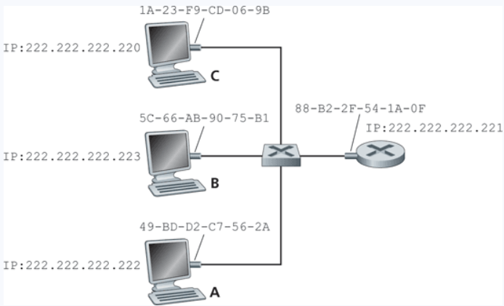
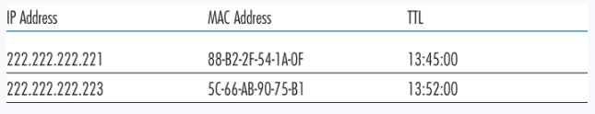
Link Layer
Protocol for mapping IP Addresses to MAC addresses
Used only for hosts and router interfaces on the same subnet
First the machine checks its ARP table
If the entry does not exist in the table, construct and send an ARP packet
On the final exam, you should know what ARP is, and when it is used
Broadcasts the ARP packet to all interfaces on the LAN (255.255.255.255)
These tables are self-updated, and do not require manual entry*

Slide 48
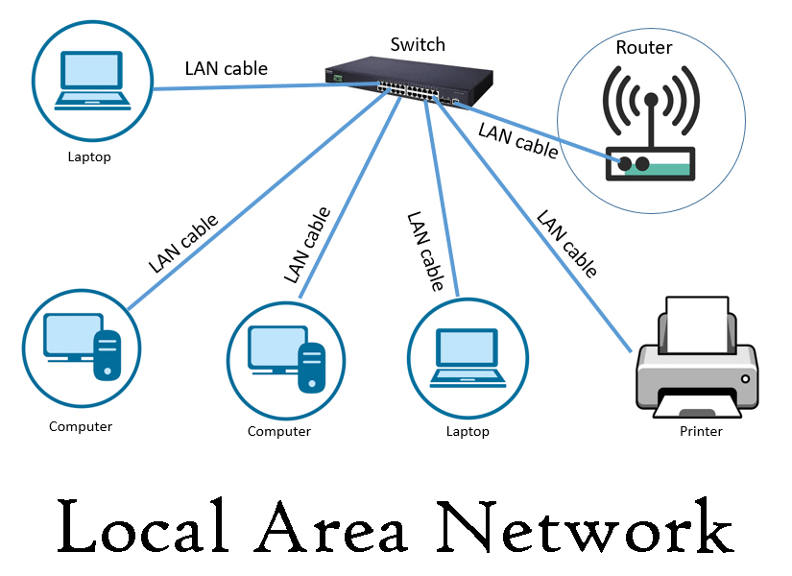
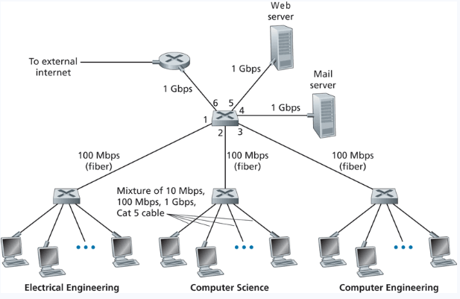
Link Layer
Local Area Network (LAN)- A collection of devices in one physical location, typically that share a centralized internet connection
Router
Switch
Challenge: Some devices in a LAN will be transmitted data at the same time, thus a collision can occur at a receiver

Slide 49
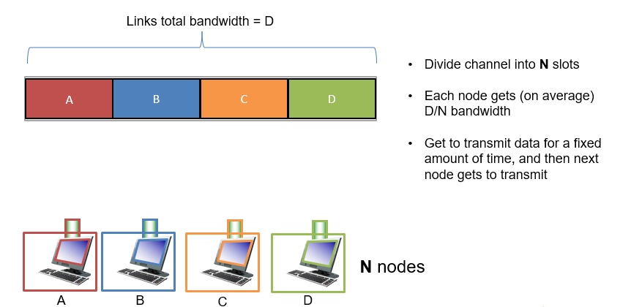
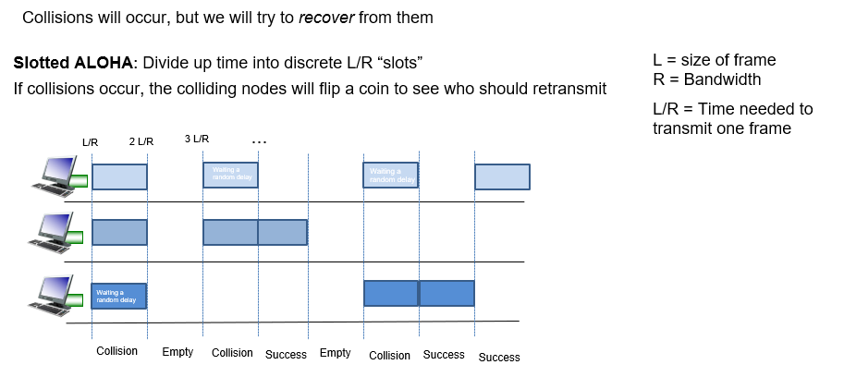
Link Layer
Dealing with Collision: Multiple Access Control Protocols
Channel Partitioning
Token Passing

Slide 50











Link Layer
Ethernet: Dominant wired LAN technology
(synchronization)
(mac addresses)
(ip datagram)
(error checking bits)
Ethernet switches will store and forward ethernet frames
Hosts have dedicated, direct connection to switch
Ethernet protocol used on each incoming link, but no collisions between links
= ethernet cable
Transparent: Hosts are not aware
they are connected to a switch
Plug and play; self-learning

Slide 51

Link Layer

Slide 52
Network Security
On the final exam, you should know the definition of these three terms
Confidentiality- Making sure that only the sender and receiver can read the message (encryption)
Authentication- Making sure that you are communicating with the person you think you are (encryption + hashing)
Integrity- Making sure the message does not get tampered with during transmission (hashing)

Slide 53



Network Security
On the final exam, you should know the differences and limitations between SCrypto, and ACrypto
Same key used for encrypting and decrypting
Using block ciphers (AES), we can encrypt an arbitrary size of data
Issue: How to securely share secret keys with each other?
Two keys: Public Key (a lock), and a price key (the key)
Public key is used to encrypt. Private key used to decrypt message
Using math, we can securely send messages over an unsecure channel without sharing any sensitive information (Diffie Hellman)
Issue: We can not encrypt stuff bigger than our key (2048 bits)
Often times, symmetric and asymmetric cryptography are used together
(use RSA to send the key for symmetric crypto!)

Slide 54

Network Security
Append a message with a shared secret (m + s)
Compute hash of (m+s) → H(m+s)
Send H(m+s) with message m
Sender sends: ( H(m+s), m)
Receiver gets ( H(m+s), m)
Append m with shared secret s (m + s)
Compute H(m+s)
The value receiver computed should match the H(m+s) he received
Used for message integrity!
No encryption required!

Slide 55



Network Security
Digital Signatures used both hashing and encryption for authentication
Bob encrypts his hashed message using his private key, and sends the signed hash, along with message to Alice. Alice decrypts using his public key and verifies that the hashes match
Sending a digital Signature
Verifying a digital signature

Slide 56







Network Security
Symmetric Crypto, Asymmetric Crypto, and Hashing all work together to send secure, authentic messages

Slide 57


Network Security
Transport Layer Security (TLS) is a protocol used to provide communication security over a TCP connection
This exists somewhere between the application layer and transport layer
Port 443
TLS will always be running if you are doing web communication with https
https = Hypertext Transfer Protocol Secure
HTTPS/TLS will handle all the encryption, key generation, certificate checking, authentication for you!
UDP does not use TLS

Slide 58



Network Security
Endpoint Security
A firewall is a combination of hardware and software that isolates an organizations internal network form the internet at large, allowing some packets to pass, and blocking others
An intrusion prevention system (IPS) filters out suspicious traffic, prior to traffic arriving to network
(Looks at packet information and other signatures)
(Looks at packet information)
An intrusion detection system (IDS) will generate an alert when potentially malicious traffic is observed
Types of Endpoint Intrusion Systems
Signature Based
Anomaly-Based

Slide 59
OSI MODEL
Application Layer
Provides protocols for sending and receiving data between services and web applications (HTTP)
Messages

Slide 60
OSI MODEL
Application Layer
Provides protocols for sending and receiving data between services and web applications (HTTP)
Messages
Presentation Layer
Encoding, Compressing, and Encrypting Data
Messages

Slide 61
OSI MODEL
Application Layer
Provides protocols for sending and receiving data between services and web applications (HTTP)
Messages
Presentation Layer
Encoding, Compressing, and Encrypting Data
Messages
Session Layer
Authentication. Manages, monitors, “sessions” between endpoints
Messages

Slide 62
OSI MODEL
Application Layer
Provides protocols for sending and receiving data between services and web applications (HTTP)
Messages
Presentation Layer
Encoding, Compressing, and Encrypting Data
Messages
Session Layer
Authentication. Manages, monitors, “sessions” between endpoints
Messages
Transport Layer
Provides host-to-host, reliable data transfer, and dictates the flow of data
Segments

Slide 63
OSI MODEL
Application Layer
Provides protocols for sending and receiving data between services and web applications (HTTP)
Messages
Presentation Layer
Encoding, Compressing, and Encrypting Data
Messages
Session Layer
Authentication. Manages, monitors, “sessions” between endpoints
Messages
Transport Layer
Provides host-to-host, reliable data transfer, and dictates the flow of data
Segments
Network Layer
Forwarding and Routing of Data. Logical Addressing
Datagrams

Slide 64
OSI MODEL
Application Layer
Provides protocols for sending and receiving data between services and web applications (HTTP)
Messages
Presentation Layer
Encoding, Compressing, and Encrypting Data
Messages
Session Layer
Authentication. Manages, monitors, “sessions” between endpoints
Messages
Transport Layer
Provides host-to-host, reliable data transfer, and dictates the flow of data
Segments
Network Layer
Forwarding and Routing of Data. Logical Addressing
Datagrams
Data Link Layer
Handles the formatting and physical addressing of the data before transmitting bits
Frames

Slide 65
OSI MODEL
Application Layer
Provides protocols for sending and receiving data between services and web applications (HTTP)
Messages
Presentation Layer
Encoding, Compressing, and Encrypting Data
Messages
Session Layer
Authentication. Manages, monitors, “sessions” between endpoints
Messages
Transport Layer
Provides host-to-host, reliable data transfer, and dictates the flow of data
Segments
Network Layer
Forwarding and Routing of Data. Logical Addressing
Datagrams
Data Link Layer
Handles the formatting and physical addressing of the data before transmitting bits
Frames
Physical Layer
Transmits bits into physical signals over some medium
Bits

Slide 66




OSI MODEL
Application Layer
A
Away
Presentation Layer
Penguin
Pizza
Session Layer
Said
Sausage
Transport Layer
That
Throw
Network Layer
Nobody
Not
Data Link Layer
Drinks
Do
Physical Layer
Pepsi
Please

Slide 67
OSI MODEL
Application Layer
Data
Presentation Layer
Data
(TLS header might also happen here)
Session Layer
Data
Transport Layer
Data
TCP Header
Network Layer
Data
TCP Header
IP Header
Data Link Layer
Data
TCP Header
IP Header
MAC Header
Physical Layer
0101010101111010100110101010101010

Slide 68
Any Questions?

Slide 69




Thank You!
Thank you for your patience, flexibility, and kindness ☺
This was a class that I never expected to teach ☺
There were a lot of long nights, and I know things were not perfect, but I am happy with how things went
I hope you enjoyed this class, and I hope the stuff you learned will be helpful in your career. Networks concepts are your veggies (boring but important)
I will be teaching 476 and 132 next semester
Connect with me on LinkedIn!
Congrats to those that are graduating next weekend! I hope you find a job that you love!
If I can be of assistance to you for anything in the future, please let me know!

